Slide 1

GE100 - Application of Information and Communication Technologies
Lec # 7: Network and Communication Devices-II
Instructor: Alina Maryum

Slide 2
Outline
Data transmission modes and characteristics
Reference Models
Communication protocols
Addressing schemes
Networking Hardware

Slide 3
BASIC ELEMENTS OF A COMMUNICATION SYSTEM
Sender (source)
Medium
Carries the message
Receiver (sink)
Creates and sends a message
Receives the message

Slide 4
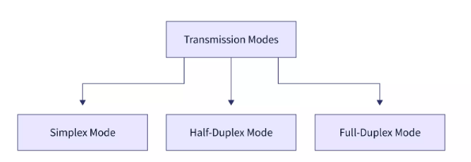
DATA TRANSMISSION MODES
The term transmission mode refers to the transmission of information between two communication devices via an interaction channel that indicates the direction of information flow between the devices.
There are three primary types of transmission modes based on the direction of the exchange of information. The first is simplex, followed by half duplex, and finally full duplex.

Slide 5
DATA TRANSMISSION MODES
Sender
Receiver
(a) Simplex
Sender (or Receiver)
Receiver (or Sender)
OR
(b) Half-duplex
Sender (and Receiver)
Receiver (and Sender)
AND
(c) Full-duplex

Slide 6
DATA TRANSMISSION MODES
The Simplex transmission mode is used in computing networks when there is a single or one-way flow of information from sender to receiver e.g., Radio, TV etc.
The half duplex mode of transmission is used in computer networks when there is a way to flow information from sender to receiver but only one at a time e.g., walkie talkie.
The Full Duplex mode of transmission is used in computing networks when there is simultaneous information flow in both directions, from sender to receiver e.g., telephone network

Slide 7
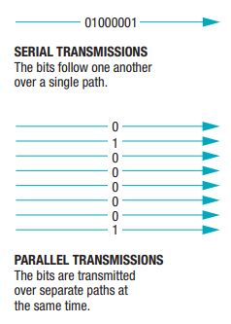
Data Transmission Characteristics
Transmission Type and Timing
Serial
Type of data transmission in which the bits travel the same path, one after the other.
Parallel
Type of data transmission in which a group of bits are transmitted at one time and each bit takes a separate path

Slide 8
Data Transmission Characteristics
Synchronous Transmission
Data is organized into groups or blocks of data, which are transferred at regular, specified intervals
Because the transmissions are synchronized, both devices know when data can be sent and when it should arrive
Most data transmissions within a computer and over a network are synchronous transmissions

Slide 9
Data Transmission Characteristics
Asynchronous Transmission
Data is sent when it is ready to be sent, without being synchronized
To identify the bits that belong in each byte, a start bit and stop bit are used at the beginning and end of the byte, respectively
This overhead makes asynchronous transmission less efficient than synchronous transmission and so it is not as widely used as synchronous transmission

Slide 10
Data Transmission Characteristics
Isochronous Transmission
Data is sent when it is ready but all data must be delivered at the time that it is needed
For example, when transmitting a video file, the audio data must be received at the proper time for it to be played with its corresponding video data
To accomplish this with isochronous transmission, the sending and receiving devices first communicate to determine the bandwidth and other factors needed for the transmission, and then the necessary bandwidth is reserved just for that transmission.

Slide 11
DIFFERENCES
No. | Synchronous Transmission | Asynchronous Transmission
1. | In Synchronous transmission, data is sent in form of blocks or frames. | In Asynchronous transmission, data is sent in form of bytes or characters.
2. | Synchronous transmission is fast. | Asynchronous transmission is slow.
3. | Synchronous transmission is costly. | Asynchronous transmission is economical.
4. | In Synchronous transmission, the time interval of transmission is constant. | In Asynchronous transmission, the time interval of transmission is not constant, it is random.
5. | In this transmission, users have to wait till the transmission is complete before getting a response back from the server. | Here, users do not have to wait for the completion of transmission in order to get a response from the server.

Slide 12
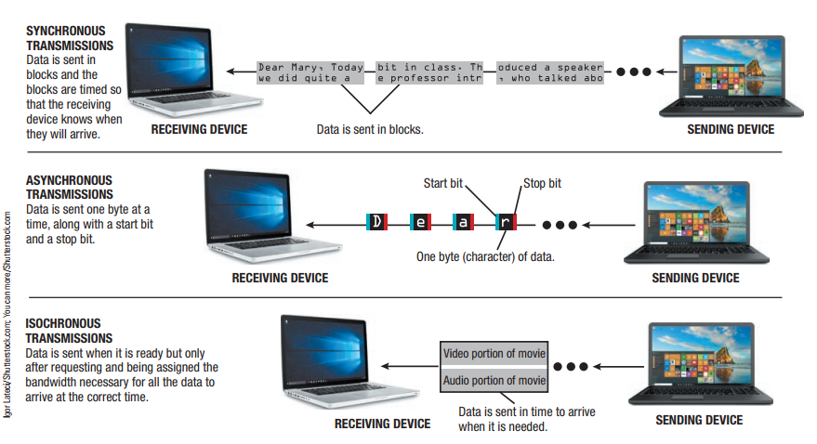
Data Transmission Characteristics

Slide 13
REFERENCE MODELS
In computer networks, reference models give a conceptual framework that standardizes communication between heterogeneous networks.
Open Systems Interconnection (OSI) Model
TCP/IP Model
Notes:
There are two well known network architectures: OSI and TCP/IP

Slide 14
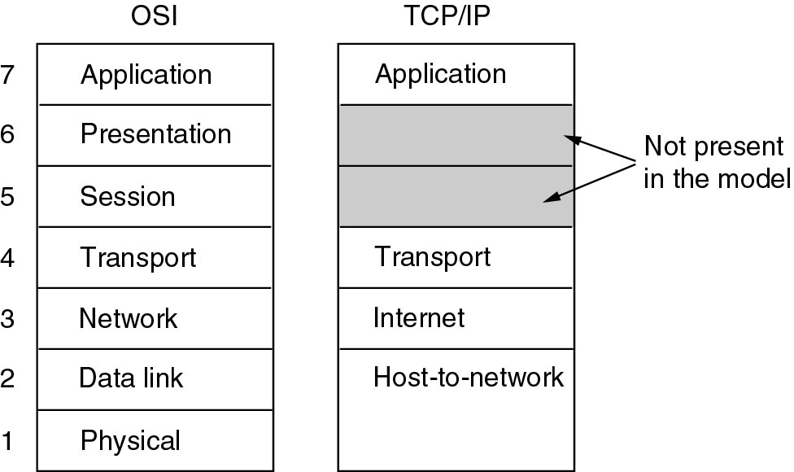
REFERENCE MODELS

Slide 15
LAYERS, INTERFACES, AND PROTOCOLS IN THE OSI MODEL
Node 1 ^{Node 2}
Process A
Process B
Layer 7 (application)
Application protocol
Layer 7 (application)
Interface
Interface
Layer 6 (presentation)
Presentation protocol
Layer 6 (presentation)
Interface
Interface
Layer 5 (session)
Session protocol
Layer 5 (session)
Interface
Interface
Layer 4 (transport)
Transport protocol
Layer 4 (transport)
Interface
Interface
Layer 3 (network)
Network protocol
Layer 3 (network)
Interface
Interface
Layer 2 (data link)
Data-link protocol
Layer 2 (data link)
Interface
Interface
Layer 1 (physical)
Physical protocol
Layer 1 (physical)
Network

Slide 16
TCP/INTERNET PROTOCOL STACK
application
transport
network
link
physical
application: supporting network applications
FTP, SMTP, HTTP
transport: host-host data transfer
TCP, UDP
network: routing of datagrams from source to destination
IP, routing protocols
link: data transfer between neighboring network elements
Ethernet
physical: bits “on the wire”

Slide 17
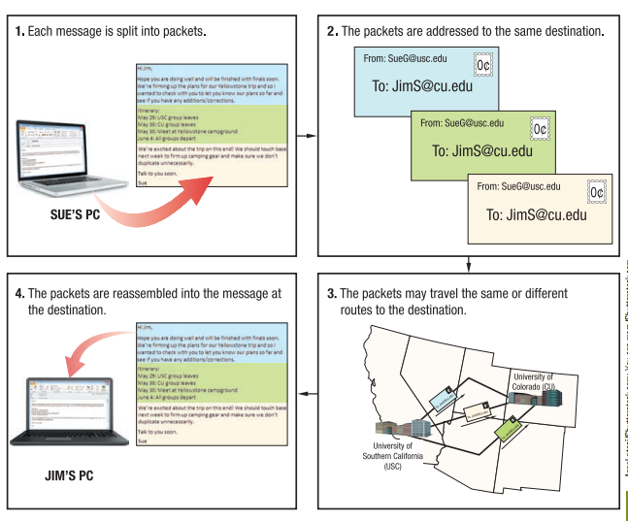
TCP/IP and Other Communications Protocols

Slide 18
COMMUNICATION PROTOCOLS
Protocol: Set of rules and regulations is called a protocol.
Communication: Exchange of information from one system to another system with a medium is called communication.
Communication Protocol: A set of rules and regulations that allow two electronic devices to connect to exchange the data with one and another.

Slide 19
COMMUNICATION PROTOCOLS
The main function of these protocols is to exchange messages from one computer system to another.
These are significant in telecommunications systems as they consistently send and receive messages.
These protocols cover error detection & correction, signaling, and authentication.

Slide 20
COMMUNICATION PROTOCOLS
Internet Protocols
Set of defined rules and procedures (or software programs) used for communication through which internet users exchange information on the network.
TCP/IP
It stands for Transmission control Protocol/ Internet protocol.
This protocol enables users (or provides connectivity between browsers and servers) for data communication on the internet.
TCP/IP manage the transmission of data on the internet by breaking the data into small pieces called packets.
Each packet contains the following information
Actual data
Destination address
Sender Address
Sequence information used to reassemble the data at the destination etc.

Slide 21
COMMUNICATION PROTOCOLS
Internet Protocols Cont…
FTP
FTP stands for File Transfer Protocol.
This protocol exchanges files between users (or you can "send" or "receive" files).
It is specially designed for uploading and downloading audio, video, graphics, and all other different types of files.
The FTP software uses this protocol for transferring files on the Internet.

Slide 22
COMMUNICATION PROTOCOLS
Internet Protocols Cont…
HTTP
HTTP stands for Hyper Text Transfer Protocol.
It is a protocol used for communication between browser and web servers. (e.g. for transferring information from web pages, stored on the web server, to the browser).
It was developed in 1990 when world wide web (www) was introduced.
HTTP uses a request/response model of communication.
A browser connects with a web server by establishing a TCP connection at port 80 of the server.
This port is the address at which web servers listen for browser requests.
Once a connection has been established, a browser send a URL request to the server. The server processes the browser’s request and sends a response back to the browser.

Slide 23
COMMUNICATION PROTOCOLS
URL
It stands for Uniform Resource Locator.
It is a unique address of web page or any other file on internet.
A URL generally starts with "http.“
For Example
http://www.nutech.edu.pk
http://google.com
Each URL consists of few parts
Prefix with protocol identifier such as “http” followed by a colon and double slashes “//”.
The domain name.
The path of the document. The forward slash “/” is used in the document path.

Slide 24
Ethernet (802.3)
Most widely used standard for wired networks
Typically used with LANs that have a star topology
Works with twisted-pair, coaxial, and fiber-optic cabling
Continually evolving
Most common today are Fast Ethernet, Gigabit Ethernet, and 10 Gigabit Ethernet
Terabit Ethernet standard is currently under development

Slide 25
Wi-Fi (802.11)
A family of wireless networking standards using IEEE standard 802.11
Current standard for wireless networks in homes and offices (wireless Ethernet)
Built into many everyday objects today
Designed for medium-range transmission typically between 100 and 300 feet indoors and 300 to 900 feet outdoors
Speed and distance depend on Wi-Fi standard being used, solid objects in the way, interference, etc.
MIMO (multiple in, multiple out) antennas are used to transfer multiple streams of data at one time

Slide 26
Addressing Schemes
Every computer connected to an internet has a unique address.
The addresses are assigned to computers according to a set of rules. These rules are called addressing schemes.
On the internet two types of addressing schemes are used. These are:
IP Addressing
DNS Addressing

Slide 27
Addressing Schemes
IP Addressing
IP stands for Internet Protocol.
It is a unique identifier that is assigned to a computer on the internet.
It is a numerical address with four numbers separated with dots.
The value of each number is between 0 and 255. These numbers are called octets
For Example IP address is : 192.168.17.43
Every computer on the internet has a unique IP address.
A server has a static IP address that does not change.
When the user’s computer connects to the ISP (Internet Service Provider), it is assigned an IP address by ISP.
This IP address is unique for that session. It is not static.
When the same computer will be connected next time, a different IP address will be assigned to it.

Slide 28
Addressing Schemes
DNS Addressing
DNS stands for Domain Name System
IP addresses are difficult to remember by users. Every server (or host) on the Internet also has a unique name. The human readable name assigned to the computer (server) on the internet is called domain name.
It is a common and unique text name that is alternative to an IP address. Such as “google.com”.
The domain name has two parts; a host name and domain name.
Domain name is also known as top-level domain (TLD).
It comes at the end of host name separated with dot (.).

Slide 29
Addressing Schemes
DNS Addressing Cont…
Some commonly used top-level domain names are:
com - Commercial business
edu - Educational institutions
gov - Government agencies
mil - Military
net - Networks organization
org - Organizations (nonprofit)

Slide 30
Data Transmission Characteristics
Delivery Method
Circuit-Switching
Dedicated path over a network is established between sender and receiver
All data follows that path from the sender to the receiver
Once connection is established, the physical path or circuit is dedicated to that connection and cannot be used by any other device until the transmission is finished
Common example of a circuit-switched network is a conventional telephone system

Slide 31
Data Transmission Characteristics
Packet-Switching
Messages are separated into small units called packets
Packets contain information about the sender and the receiver, the actual data being sent, and information about how to reassemble the packets to reconstruct the original message
Packets travel along the network separately, based on their final destination, network traffic, and other network conditions
When the packets reach their destination, they are reassembled in the proper order

Slide 32
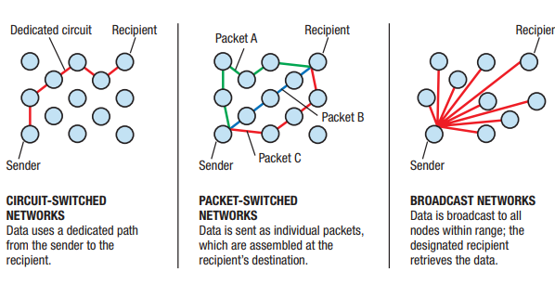
Data Transmission Characteristics
Broadcasting
Data is sent out (typically in packets) to all nodes on a network and is retrieved only by the intended recipient
Broadcasting is used primarily with LANs

Slide 33
Networking Hardware
Switch
Central device that connects devices in a wired network but only sends data to the intended recipient
Hub – similar but sends data to all recipients
Router
Connects multiple networks: two LANs, two WANS, LAN and the Internet
Passes data to intended recipient only
Routes traffic over the Internet
Wireless Access Point
Device used to grant network access to wireless client devices

Slide 34
Networking Hardware
Wireless Router
Typically connects both wired and wireless devices to a network and to connect the network to the Internet
Often integrates a switch, router, and wireless access point
Bridge
Used to connect two LANs together
In a home network, wirelessly connects a wired device to the network

Slide 35
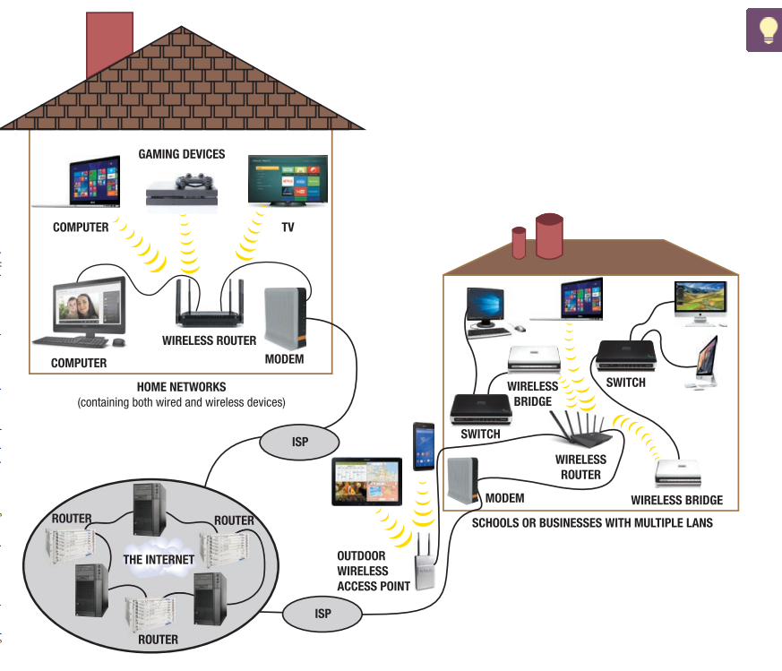
Networking Hardware

Slide 36
OSI Model
The OSI Model (Open Systems Interconnection) is a conceptual framework with seven layers, designed to standardize and understand network communication. Each layer has a specific role in the process of sending or receiving data.
OSI Model was developed by the International Organization for Standardization (ISO). The OSI Model consists of 7 layers and each layer has specific functions and responsibilities.

Slide 37
Layers of the OSI Model
There are 7 layers in the OSI Model and each layer has its specific role in handling data. All the layers are mentioned below:
Physical Layer
Data Link Layer
Network Layer
Transport Layer
Session Layer
Presentation Layer
Application Layer

Slide 38
Layer 1: Physical Layer
The Physical Layer is the lowest layer in the OSI model, responsible for the actual physical connection between devices. It handles the transmission and reception of raw binary data (bits) over a physical medium. When receiving data, this layer converts the incoming signals into binary data (0s and 1s) and passes them to the Data Link Layer, which reconstructs the frame.

Slide 39
Layer 1: Physical Layer
Key Responsibilities of the Physical Layer
Bit Transmission
Facilitates the transmission of individual bits from one device to another through a physical medium.
Bit Synchronization
Provides synchronization by using a clock signal to ensure the sender and receiver are in sync at the bit level.
Bit Rate Control
Defines the transmission speed, specifying the number of bits transmitted per second.
Full-Duplex: Data flows in both directions simultaneously.

Slide 40
Layer 1: Physical Layer
Key Responsibilities of the Physical Layer
Physical Topologies
Determines how devices are arranged in a network, supporting layouts
Transmission Modes
Defines how data flows between devices
Physical Layer Devices
Hubs
Repeaters
Modems
Cables

Slide 41
Layer 2: Data Link Layer
The Data Link Layer is the second layer in the OSI model, responsible for node-to-node delivery of messages. It ensures error-free data transfer between adjacent nodes over the Physical Layer.
When a packet arrives at the Data Link Layer, it is encapsulated into a Frame, and its delivery to the correct device is facilitated using the MAC (Media Access Control) address.

Slide 42
Layer 2: Data Link Layer
Key Responsibilities of the Data Link Layer
Error Detection and Correction - Ensures reliable data transfer by detecting and correcting errors in transmitted frames.
Framing - Divides data into manageable Frames for transmission. Each frame includes headers and trailers for addressing and error checking.
Flow Control - Manages data transmission rates to prevent fast senders from overwhelming slower receivers.
Access Control - Determines which device has permission to use the communication channel at any given time.
Node-to-Node Delivery - Ensures data is delivered between directly connected devices using MAC addresses.
Data Link Layer Devices
Switches
Bridges

Slide 43
Layer 3 – Network Layer
The Network Layer is the third layer in the OSI model, responsible for the logical addressing, routing, and delivery of data packets across different networks. It ensures that packets are forwarded from the source to the destination, potentially traversing multiple networks in the process.
Key Responsibilities of the Network Layer
Logical Addressing
Assigns logical addresses (e.g., IP addresses) to devices, enabling unique identification and communication between them.
Source Address: Identifies the sender.
Destination Address: Identifies the intended recipient.
Routing
Determines the best path for data packets to travel across interconnected networks using routing algorithms and protocols.
Routes packets based on factors like network congestion and topology.

Slide 44
Layer 3 – Network Layer
Key Responsibilities of the Network Layer
Packet Fragmentation and Reassembly
Fragmentation: Breaks large packets into smaller fragments to fit the underlying network’s Maximum Transmission Unit (MTU).
Reassembly: Combines fragments at the destination to reconstruct the original packet.
Packet Switching
Facilitates efficient delivery of packets by switching paths dynamically as per the network conditions.
Error Handling and Diagnostics
Detects and manages errors in packet delivery (e.g., unreachable destination).
Uses protocols like ICMP for diagnostic purposes.

Slide 45
Layer 3 – Network Layer
Network Layer Devices
Routers: Forward packets between different networks based on logical addresses.
Layer 3 Switches: Perform routing functions within the same hardware as a traditional switch.

Slide 46
Layer 4: Transport Layer
The Transport Layer is the fourth layer in the OSI model, responsible for the end-to-end delivery of data between applications on different devices. It ensures reliable communication, manages data segmentation and reassembly, and provides error checking for efficient data transfer.

Slide 47
Layer 4: Transport Layer
Key Responsibilities of the Transport Layer
Segmentation and Reassembly
Segmentation: Divides large data into smaller, manageable units called segments.
Reassembly: Combines received segments into the original data at the destination.
Connection Management
Establishes, maintains, and terminates logical connections between applications using:
Connection-Oriented Protocols (e.g., TCP).
Connectionless Protocols (e.g., UDP).

Slide 48
Layer 4: Transport Layer
Flow Control
Prevents data loss by managing the data transmission rate between sender and receiver.
Example: TCP uses techniques like sliding windows to handle flow control.
Error Detection and Correction
Ensures the integrity of transmitted data by detecting and correcting errors.
Example: TCP uses checksums for error checking.
Multiplexing and Demultiplexing
Multiplexing: Allows multiple applications to send data simultaneously by assigning port numbers.
Demultiplexing: Ensures the data is delivered to the correct application on the receiving device.

Slide 49
Layer 4: Transport Layer
Transport Layer Devices
Gateways (specialized routers) handle Transport Layer operations in some scenarios.

Slide 50
Layer 5: Session Layer
The Session Layer is the fifth layer in the OSI model, responsible for establishing, managing, and terminating sessions (or conversations) between applications on different devices. It provides mechanisms to ensure organized and synchronized communication.
Key Responsibilities of the Session Layer
Session Management
Establishes, maintains, and terminates sessions between applications.
Ensures that sessions remain active and are properly closed when communication ends.
Dialog Control
Manages the flow of information by controlling the mode of communication:
Simplex: Data flows in one direction.
Half-Duplex: Data flows in both directions, but one direction at a time.
Full-Duplex: Data flows in both directions simultaneously.

Slide 51
Layer 5: Session Layer
Key Responsibilities of the Session Layer
Synchronization
Inserts checkpoints in data streams for resuming communication after interruptions.
Ensures data consistency during long transmissions.
Authentication and Authorization
Verifies the identity of participants and ensures secure access to data or applications.
Session Recovery
Recovers sessions in case of disconnection or failure by resuming from the last checkpoint.

Slide 52
Layer 6: Presentation Layer
The Presentation Layer is the sixth layer in the OSI model, often referred to as the translator or syntax layer. It is responsible for translating data between the application layer and the network, ensuring data is in a usable format for the recipient. This layer also manages encryption, compression, and data formatting, ensuring secure and efficient communication.

Slide 53
Layer 6: Presentation Layer
Key Responsibilities of the Presentation Layer
Data Translation
Converts data into a format understandable by the receiving device.
Examples include translating between ASCII (text) and binary formats.
Data Encryption and Decryption
Ensures data security by encrypting data before transmission and decrypting it upon reception.
Examples: Secure Socket Layer (SSL) for encrypted communications.
Data Compression and Decompression
Reduces the size of data to optimize transmission speed and bandwidth usage.
Example: JPEG compression for images.
Data Formatting
Formats data based on application requirements, such as file structures or multimedia content (e.g., audio, video).
Examples: Converting between image formats like PNG and JPEG.

Slide 54
Layer 7: Application Layer
The Application Layer is the topmost layer of the OSI model, closest to the end-user. It provides the interface for communication between the user and the network, enabling applications to send and receive data over the network. This layer is responsible for identifying communication partners, ensuring data integrity, and offering services like email, file transfer, and web browsing.

Slide 55
Layer 7: Application Layer
Key Responsibilities of the Application Layer
User Interface
Provides the means for users to interact with the network through applications.
Examples: Web browsers, email clients, and file-sharing programs.
Network Resource Access
Enables applications to access resources and services on the network, such as databases or servers.
Service Advertisement
Ensures that services (like file sharing or printing) are available and accessible to other devices on the network.
Data Synchronization
Ensures that data across multiple devices or locations remains consistent.
Error Handling
Manages and reports communication errors to the user.

Slide 56
Layer 7: Application Layer
Practical Examples
Web Browsing: Accessing websites through HTTP/HTTPS.
Email: Sending and receiving emails via SMTP, IMAP, or POP3.
Cloud Services: Accessing cloud-based applications like Google Drive or Dropbox.
Streaming Services: Watching videos on platforms like YouTube or Netflix using RTP (Real-Time Protocol).

Slide 57
How Data Flows in the OSI Model?
When we transfer information from one device to another, it travels through 7 layers of OSI model. First data travels down through 7 layers from the sender’s end and then climbs back 7 layers on the receiver’s end.
Data flows through the OSI model in a step-by-step process:\
Application Layer: Applications create the data.
Presentation Layer: Data is formatted and encrypted.
Session Layer: Connections are established and managed.
Transport Layer: Data is broken into segments for reliable delivery.
Network Layer: Segments are packaged into packets and routed.
Data Link Layer: Packets are framed and sent to the next device.
Physical Layer: Frames are converted into bits and transmitted physically.

Slide 58
Example of Data flow via OSI model
We can understand how data flows through OSI Model with the help of an example mentioned below.
Let us suppose, Person A sends an e-mail to his friend Person B.
Step 1: Person A interacts with e-mail application like Gmail, outlook, etc. Writes his email to send. (This happens at Application Layer).
Step 2: At Presentation Layer, Mail application prepares for data transmission like encrypting data and formatting it for transmission.
Step 3: At Session Layer, There is a connection established between the sender and receiver on the internet.
Step 4: At Transport Layer, Email data is broken into smaller segments. It adds sequence number and error-checking information to maintain the reliability of the information.

Slide 59
Cont..
Step 5: At Network Layer, Addressing of packets is done in order to find the best route for transfer.
Step 6: At Data Link Layer, data packets are encapsulated into frames, then MAC address is added for local devices and then it checks for error using error detection.
Step 7: At Physical Layer, Frames are transmitted in the form of electrical/ optical signals over a physical network medium like ethernet cable or WiFi.
After the email reaches the receiver i.e. Person B, the process will reverse and decrypt the e-mail content. At last, the email will be shown on Person B email client.

Slide 60
Sender Side: From Application Layer to Physical Layer
Application Layer (Layer 7)
Function: Provides network services to user applications like web browsers or email clients.
Example: A user sends an email using a client (e.g., Outlook).
Process:
The application generates data for communication (e.g., the email message).
Protocols like HTTP, SMTP, or FTP format the data.
2. Presentation Layer (Layer 6)
Function: Prepares data for transfer by formatting, encrypting, or compressing it.
Example: Converts the text of the email to a standard format like ASCII or encrypts it using SSL/TLS.
Process:
Converts data into a standard format that both sender and receiver can understand.
Optionally compresses the data to reduce size for faster transmission.

Slide 61
Sender Side: From Application Layer to Physical Layer
3. Session Layer (Layer 5)
Function: Manages and maintains the session between the sender and receiver.
Example: Establishes a session for the email transfer.
Process:
Opens a session (dialog) between the devices.
Maintains synchronization for data exchange and ensures the session can resume after interruptions.

Slide 62
Sender Side: From Application Layer to Physical Layer
4. Transport Layer (Layer 4)
Function: Ensures reliable transmission of data between sender and receiver.
Example: Splits the email data into segments using TCP or datagrams using UDP.
Process:
Segmentation: Divides data into manageable chunks (segments/datagrams).
Adds a header containing sequence numbers and port numbers.
Ensures error checking and flow control mechanisms are in place.

Slide 63
Sender Side: From Application Layer to Physical Layer
5. Network Layer (Layer 3)
Function: Handles logical addressing and routing of data.
Example: Assigns an IP address to identify the sender and receiver.
Process:
Encapsulates each segment with an IP header, forming packets.
Uses routing protocols to decide the best path for the packets to reach the destination.

Slide 64
Sender Side: From Application Layer to Physical Layer
6. Data Link Layer (Layer 2)
Function: Provides error detection and physical addressing within a local network.
Example: Uses MAC addresses for communication within the same network.
Process:
Encapsulates packets into frames with MAC address headers.
Performs error checking using mechanisms like CRC.
Prepares data for physical transmission.

Slide 65
Sender Side: From Application Layer to Physical Layer
7. Physical Layer (Layer 1)
Function: Transmits raw binary data (bits) over the physical medium.
Example: Converts frames into electrical signals (wired) or radio waves (wireless).
Process:
Sends the bits as physical signals through the transmission medium (e.g., cables or air).

Slide 66
Receiver Side: From Physical Layer to Application Layer
1. Physical Layer (Layer 1)
Function: Receives raw signals and converts them back into binary data (bits).
Process:
The signals are interpreted as binary data and passed up to the Data Link Layer.

Slide 67
Receiver Side: From Physical Layer to Application Layer
2. Data Link Layer (Layer 2)
Function: Verifies the integrity of frames and removes the MAC header.
Process:
Performs error checking to ensure data integrity.
Extracts the packet from the frame and passes it to the Network Layer.

Slide 68
Receiver Side: From Physical Layer to Application Layer
3. Network Layer (Layer 3)
Function: Handles routing and logical addressing.
Process:
Verifies the IP address to ensure the packet is for this device.
Removes the IP header and passes the segment to the Transport Layer.

Slide 69
Receiver Side: From Physical Layer to Application Layer
4. Transport Layer (Layer 4)
Function: Reassembles data segments and ensures reliable delivery.
Process:
Checks the sequence numbers to reassemble the segments in the correct order.
Verifies error-checking codes and handles retransmissions if necessary.
Passes the reassembled data to the Session Layer.

Slide 70
Receiver Side: From Physical Layer to Application Layer
5. Session Layer (Layer 5)
Function: Manages the session and ensures data consistency.
Process:
Synchronizes the session and resumes any interrupted communication.
Passes the data to the Presentation Layer.

Slide 71
Receiver Side: From Physical Layer to Application Layer
6. Presentation Layer (Layer 6)
Function: Converts data into a format usable by the application.
Process:
Decrypts and decompresses the data if necessary.
Transforms it into a readable format (e.g., text for an email client).

Slide 72
Receiver Side: From Physical Layer to Application Layer
7. Application Layer (Layer 7)
Function: Provides the final data to the user application.
Process:
Displays the data (e.g., the email message) in the application interface.

